Slide 1
Credit Card Fraud Detection Pipeline
An End-to-End Machine Learning Workflow
Presented by:
Rache Morris
Esteban Ortega
Haby Sarr
Krishna Sigdel

Slide 2
Data Ingestion
Loaded creditcard_sample.csv using pandas
Explored structure, null values, and class imbalance
Confirmed fraud class was underrepresented

Slide 3
Data Cleaning & Preprocessing
Removed outliers in Amount using IQR
Convert timestamp to Datetime
Extracted Hour and DayOfWeek features
One-hot encoded time features

Slide 4
Feature Engineering
Computed count of transactions in last 1 hour per user
Dropped IDs and datetime to prevent data leakage
One-hot encoded categorical features:
Card type, Entry mode, Merchant group, etc.

Slide 5
Target & Data Splitting
Target column: Fraud or Class (binary: 0 = No, 1 = Yes)
Converted strings to binary if needed
Used stratified train_test_split to maintain class ratio

Slide 6
Data Storage
Saved processed data to an SQLite database
Verified schema and queried data (e.g., only fraud rows)

Slide 7
Model Training
Built ML pipeline: StandardScaler → SMOTE → RandomForestClassifier
Used full training set with oversampling

Slide 8
Hyperparameter Tuning
Tuned n_estimators, max_depth, class_weight
Used GridSearchCV with 3-fold cross-validation
Selected best-performing model

Slide 9
Evaluation Metrics
Confusion Matrix: Visual breakdown of results
Classification Report: Precision, Recall, F1-score
ROC Curve & AUC: Measures model confidence
Precision-Recall Curve: Best for imbalanced data

Slide 10
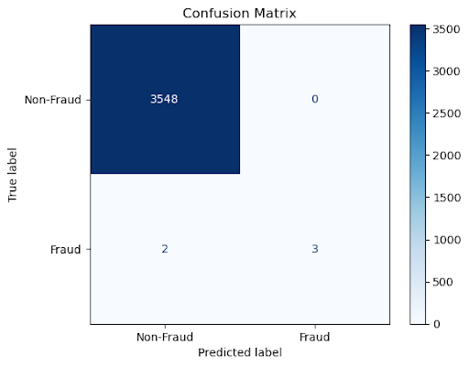
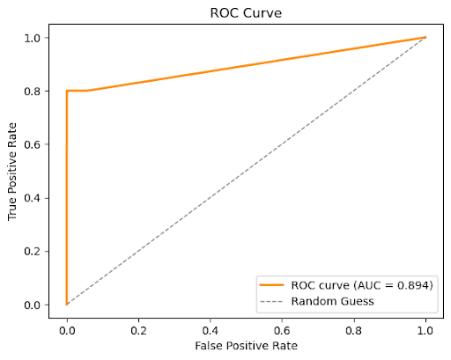
Confusion Matrix and ROC Curve

Slide 11
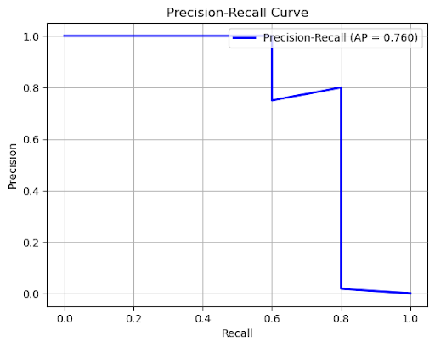
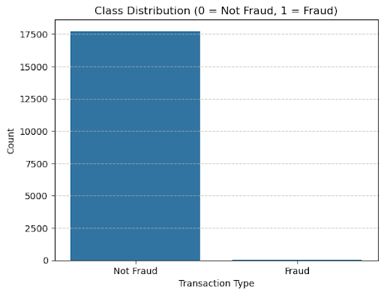
Precision-Recall curve and Class distribution

Slide 12
Feature Importance
Identified top 10 important features
Visualized scores from Random Forest
Helps interpret and validate model behavior

Slide 13
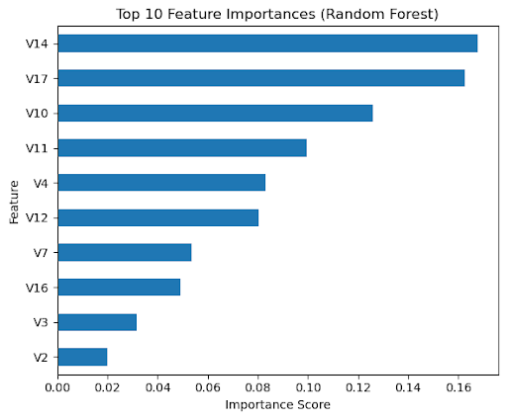
Random Forest

Slide 14
t-SNE Visualization
Used t-SNE to reduce data to 2D
Plotted fraud vs. non-fraud to visualize separation
Helpful for understanding class overlap

Slide 15
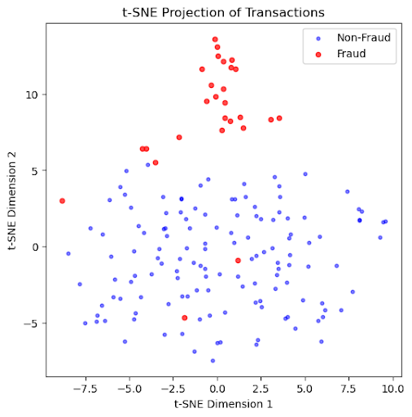
t-SNE projection of transactions

Slide 16
Conclusion
Built a complete fraud detection pipeline
Included ETL, feature engineering, model training, and evaluation
Model ready for deployment or integration into systems
Can be improved with real-time streaming and alerting

